Slide 1

Aim Games Platform
The reference platform for game-making resources
Group 7
Speaker: Mario Bizcocho González

Slide 2









A great way to get resources!

Slide 3
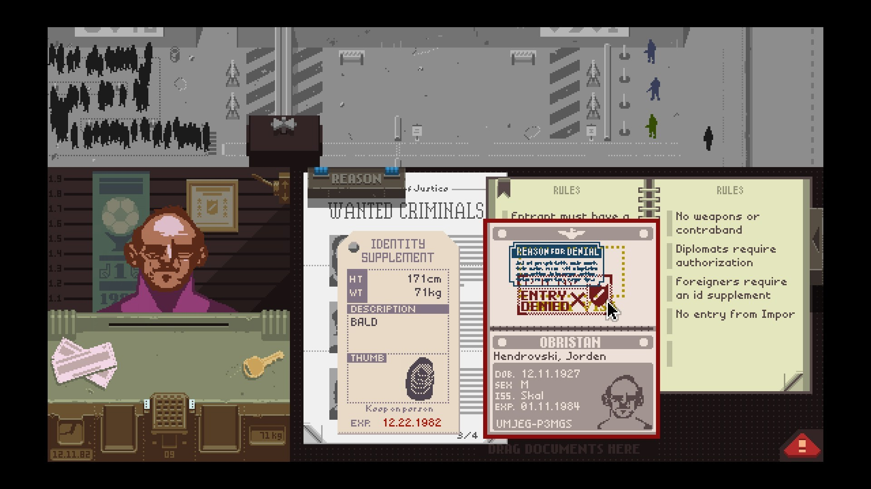
Papers, Please (Lukas Pope, 2013)

Slide 4
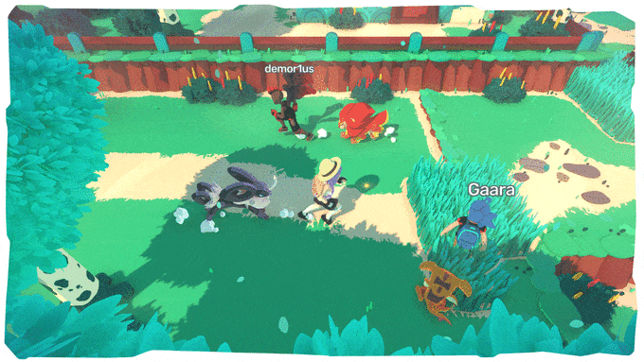
TemTem (CremaGames, 2019)

Slide 5
450 incorporated studios
Spain, 2017 (AEVI Yearly Report)
+620 unincorporated (estimate, Devuego) =
1070 national studios

Slide 6
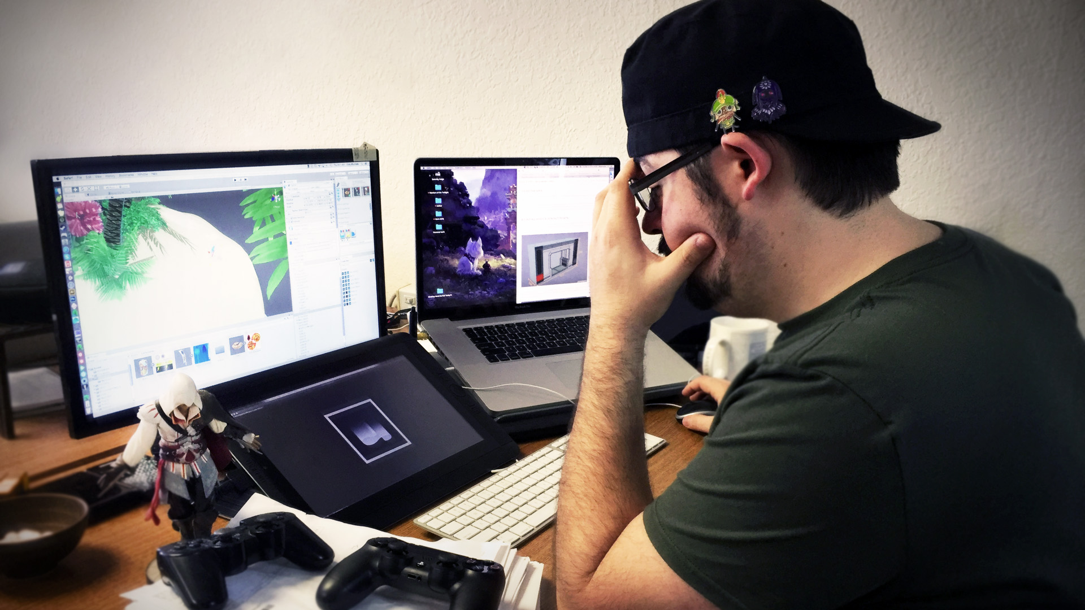
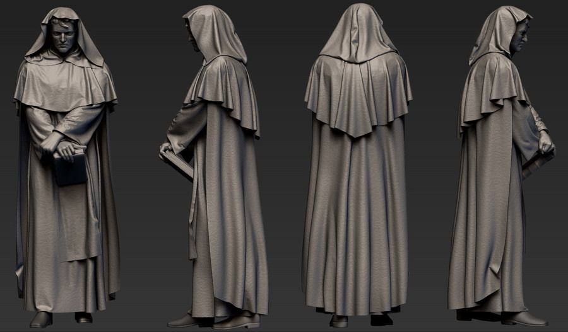
What do they need?

Slide 7

Contents
What is Aim Games?
Demonstration
Where we are
Team composition
Productivity control
Piloting plan
Issues faced
Next steps

Slide 8
Contents
What is Aim Games?
Demonstration
Where we are
Team composition
Productivity control
Piloting plan
Issues faced
Next steps

Slide 9
What is Aim Games?
Andalusian Association for the Promotion of Videogames
Provides human and technological resources
Includes experienced professionals

Slide 10
How are we making money?
Government aids
Company membership fees
Sublicensing administrative Access
Development events

Slide 11
Competitor analysis
 | AIM Games | Linkedin | Infojobs | Stratos | Icaro | Primerempleo | Jobrapido | Trabajos.com | Ibereoempleos
Forum | ✓ | ❌ | ❌ | ✓ | ❌ | ❌ | ❌ | ❌ | ❌
Verify CV | ✓ | ❌ | ❌ | ❌ | ❌ | ❌ | ❌ | ❌ | ❌
Share Resources | ✓ | ❌ | ❌ | ✓ | ❌ | ❌ | ❌ | ❌ | ❌
Direct Messaging | ✓ | ✓ | ❌ | ❌ | ❌ | ❌ | ❌ | ❌ | ❌
Courses | ✓ | ✓ | ✓ | ✓ | ❌ | ✓ | ❌ | ✓ | ✓
Company profiles | ✓ | ❌ | ✓ | ✓ | ✓ | ✓ | € | € | ✓
Sector specific | ✓ | ❌ | ❌ | ✓ | ❌ | ❌ | ❌ | ❌ | ❌
Organises events | ✓ | ❌ | ❌ | ❌ | ❌ | ❌ | ❌ | ❌ | ❌
Can challenge applicants | ✓ | ❌ | ❌ | ❌ | ❌ | ❌ | ❌ | ❌ | ❌
Notes:
AEVI: Asociación Española del Videojuego
STRATOS: offers both job opportunities and collaboration opportunities, the latter do not necessarily involve economical retribution. Also, severe lack of offers in Andalusia. Resembles a forum.
ICARO insecure: GET hacking when editing curricula

Slide 12
Differentiation
Intuitive design
Credibility
Proximity
Collaboration

Slide 13
Contents
What is Aim Games?
Demonstration
Where we are
Team composition
Productivity control
Piloting plan
Issues faced
Next steps

Slide 14
Contents
What is Aim Games?
Demonstration
Where we are
Team composition
Productivity control
Piloting plan
Issues faced
Next steps

Slide 15
Where we are
Second iteration successful
Pilot plan carried out, data being analysed and solutions proposed
Added challenges, events and message system

Slide 16

Where we are
1 | 2 | 3 | 4 | 5 | 6 | 7 | 8 | 9 | 10 | 11 | 12 | 13 | 14

Slide 17
Where we are
Concept | Net cost
Direct costs (salaries, social costs, others) | €32258.01
Indirect costs | €322.58
Reserves | €3258.06
Profit | €4887.09
Total before tax | €40725.74
VAT (21%) | €8552.41
Total | €49278.15
Notes:
Capital revenue: regional government aids to associations, company membership fees,

Slide 18
Where we are
Name | Role | Price/hour | Invested hours | Gross Salary | Social costs | Total
De la Fuente Bonilla, Fco. Javier | CEO, Project Manager | 25€/h | 150h | 3750€ | 1124.63€ | 4874.63€
Molina Domínguez, Jorge Manuel | CCO, CIO | 22,73€/h | 150h | 3409,5€ | 1022.51€ | 4432.01€
Bizcocho González, Mario | CMO, Speaker | 22,73€/h | 150h | 3409,5€ | 1022.51€ | 4432.01€
Monteseirín Puig, Alejandro | Full-stack Developer | 18,54€/h | 150h | 2781€ | 834.03€ | 3615.03€
Pérez Piñero, Iván | Backend Developer | 15,37€/h | 150h | 2305.5€ | 689.35€ | 2994.85€
Arenas Arenas, Antonio | Frontend Developer | 15,37€/h | 150h | 2305.5€ | 689.35€ | 2994.85€
Santos Batista, Miguel | Full-stack Developer | 18,54€/h | 150h | 2781€ | 834.03€ | 3615.03€
Pazo Jiménez, Pablo | Backend Developer | 15,37€/h | 150h | 2305.5€ | 689.35€ | 2994.85€
 |  |  |  | 23047,5€ | 6905.76€ | 29953,75€
Notes:
Capital revenue: regional government aids to associations, company membership fees,

Slide 19
Where we are

Slide 20
Contents
What is Aim Games?
Demonstration
Where we are
Team composition
Productivity control
Piloting plan
Issues faced
Next steps

Slide 21
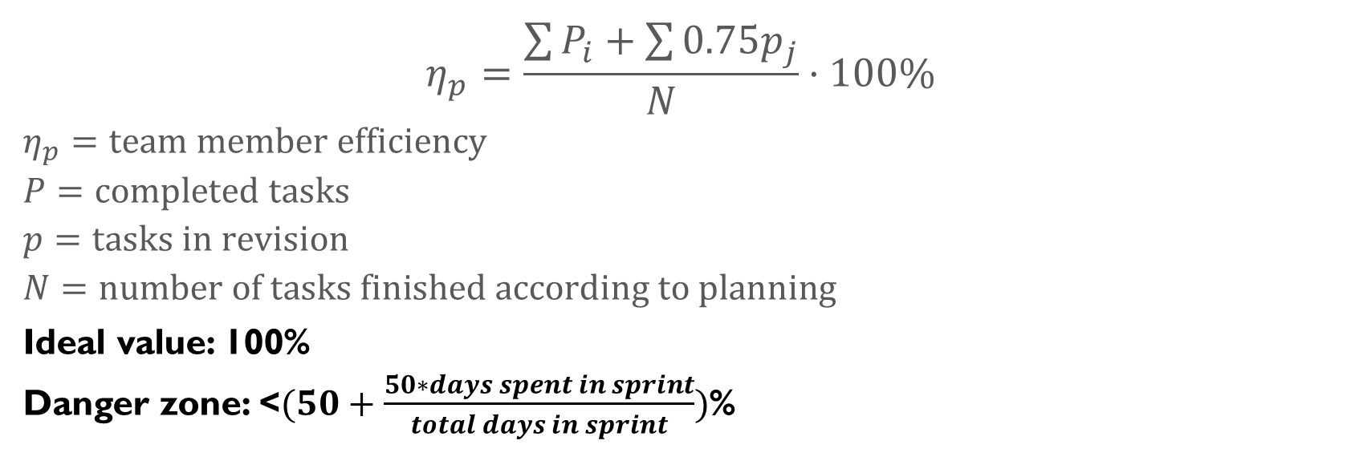
Productivity plan
$$η_{p}=\frac{\sum{P_{i}}+\sum{{0.75p}_{j}}}{N}·100\%$$
$$η_{p}=team member efficiency$$
$$P=completed tasks$$
$$p=tasks in revision$$
$$N=number of tasks finished according to planning$$
Ideal value: 100%
Danger zone: <$(50+\frac{50∗days spent in sprint}{total days in sprint})$%

Slide 22
Punishment strategy
3 warning system
Expulsion at the 3rd warning
Automatic warning for incompletion
Proposed warning (voting)
Pardoning of warning on sprint without incidents

Slide 23
Contents
What is Aim Games?
Demonstration
Where we are
Team composition
Productivity control
Piloting plan
Issues faced
Next steps

Slide 24
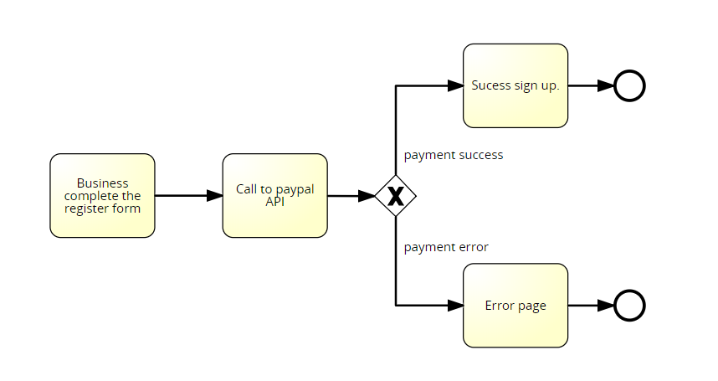


Issues faced
Issue 1: PayPal
Issue 2: Database
Issue 3: Git

Slide 25

Issues faced
Issue 4: Manager role

Slide 26

Issues faced
Issue 5: PowerPoint bug

Slide 27
Contents
What is Aim Games?
Demonstration
Where we are
Team composition
Productivity control
Piloting plan
Issues faced
Next steps

Slide 28


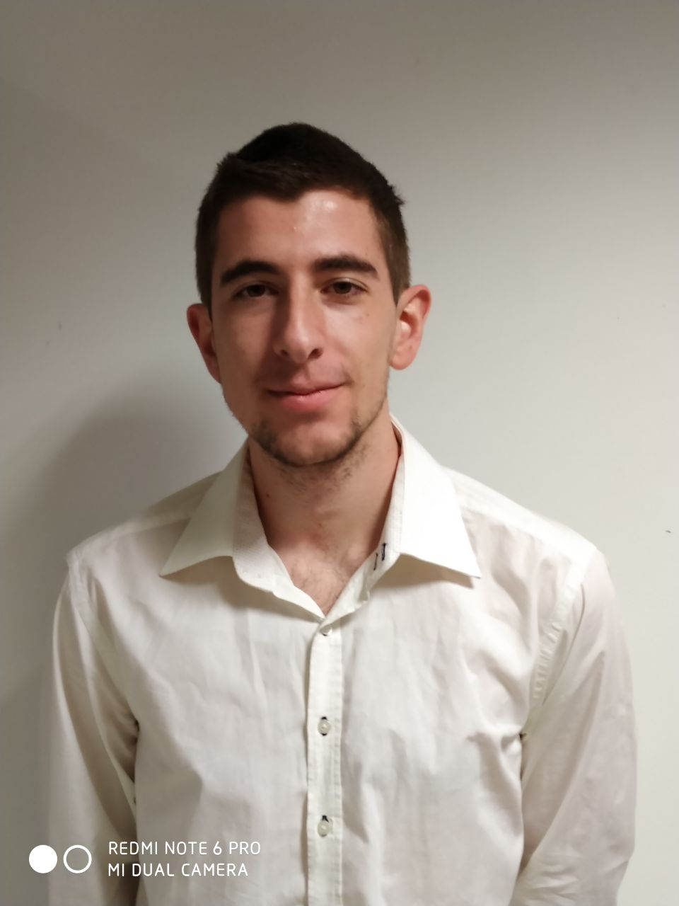
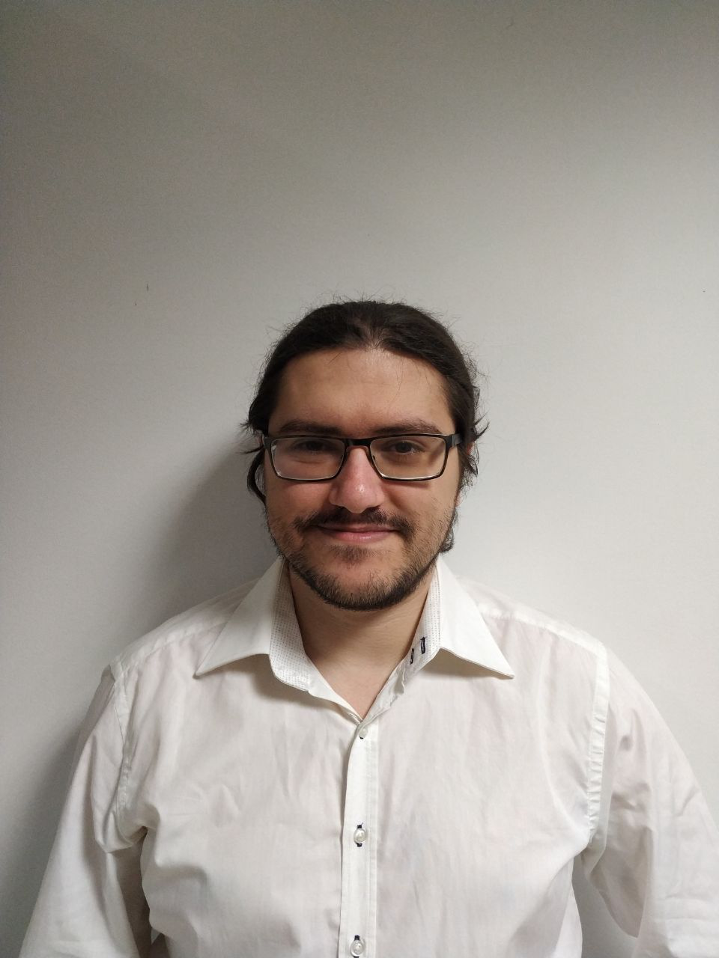
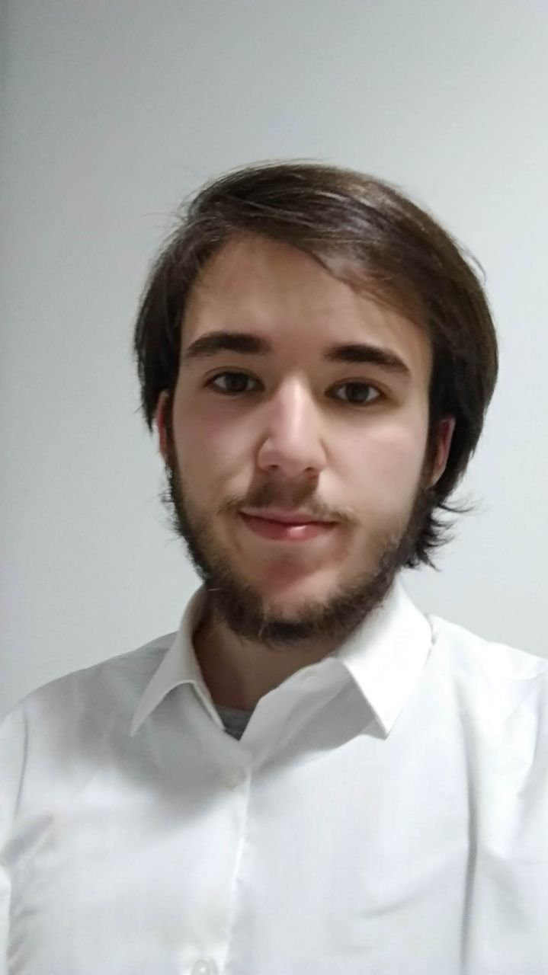
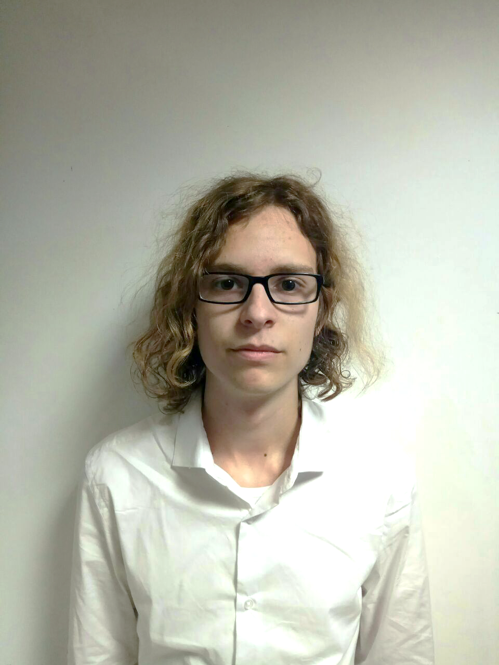

Team composition
= 100%
Fco. Javier de la Fuente Bonilla | Jorge Manuel Molina Domínguez | Mario Bizcocho González | Alejandro Monteseirín Puig
Project manager, CEO | CCO, CIO | Speaker, CMO | Full-stack developer
100%
100%
100%
100%
17
/
18
15
/
16
(h)
22
/
20
23
/
20
Notes:
Grupo 7

Slide 29
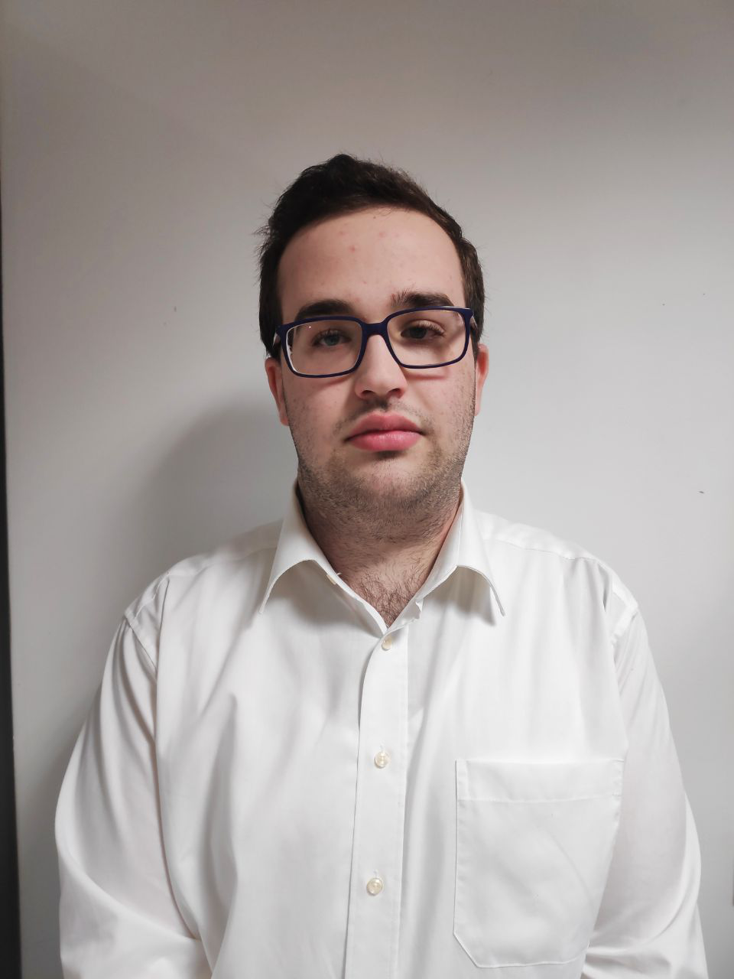
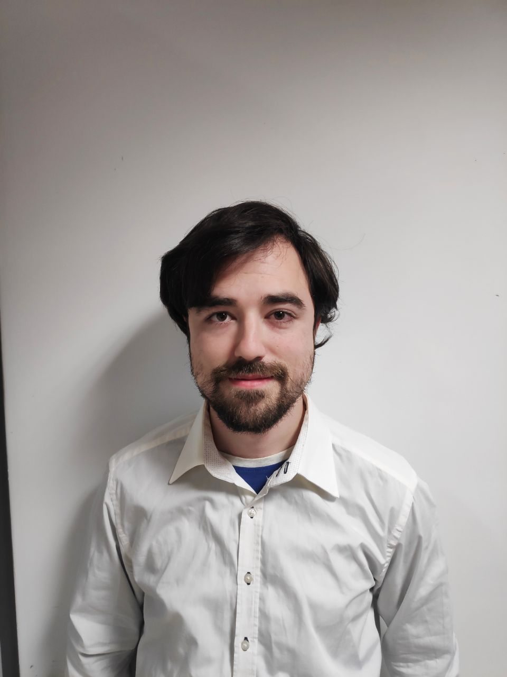
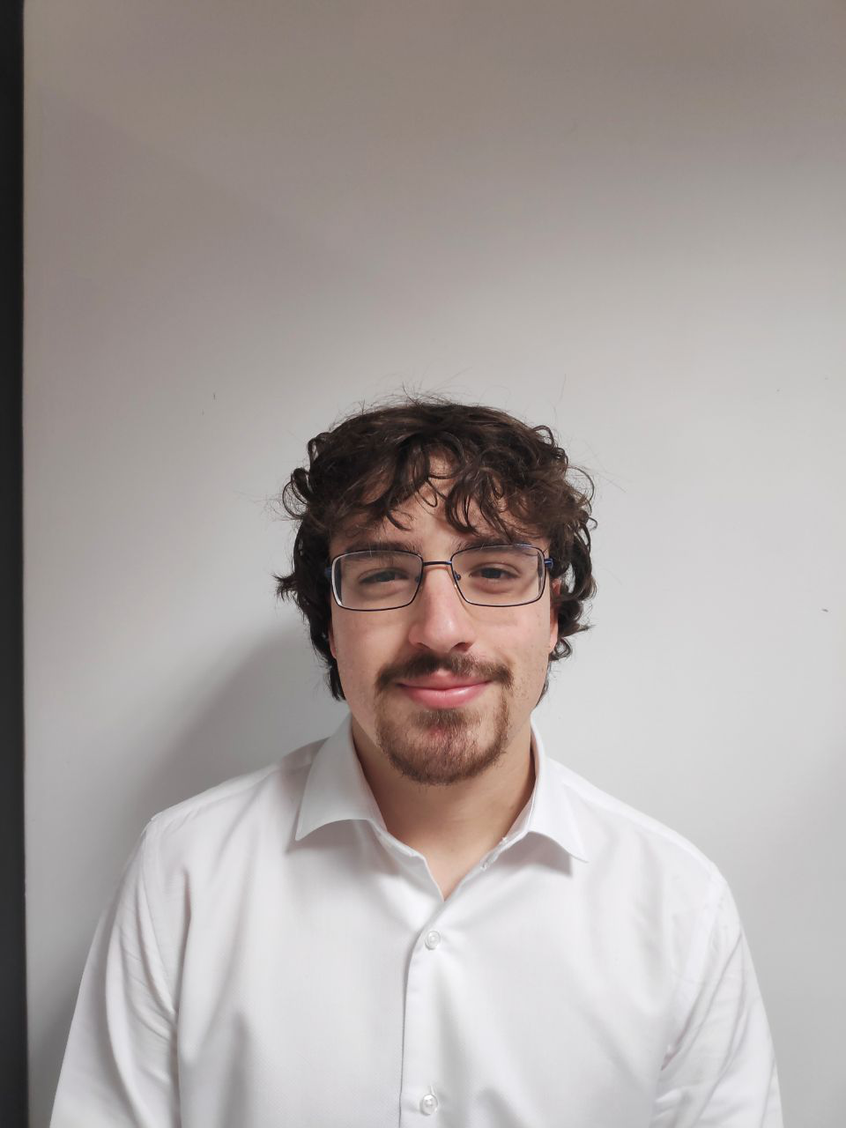
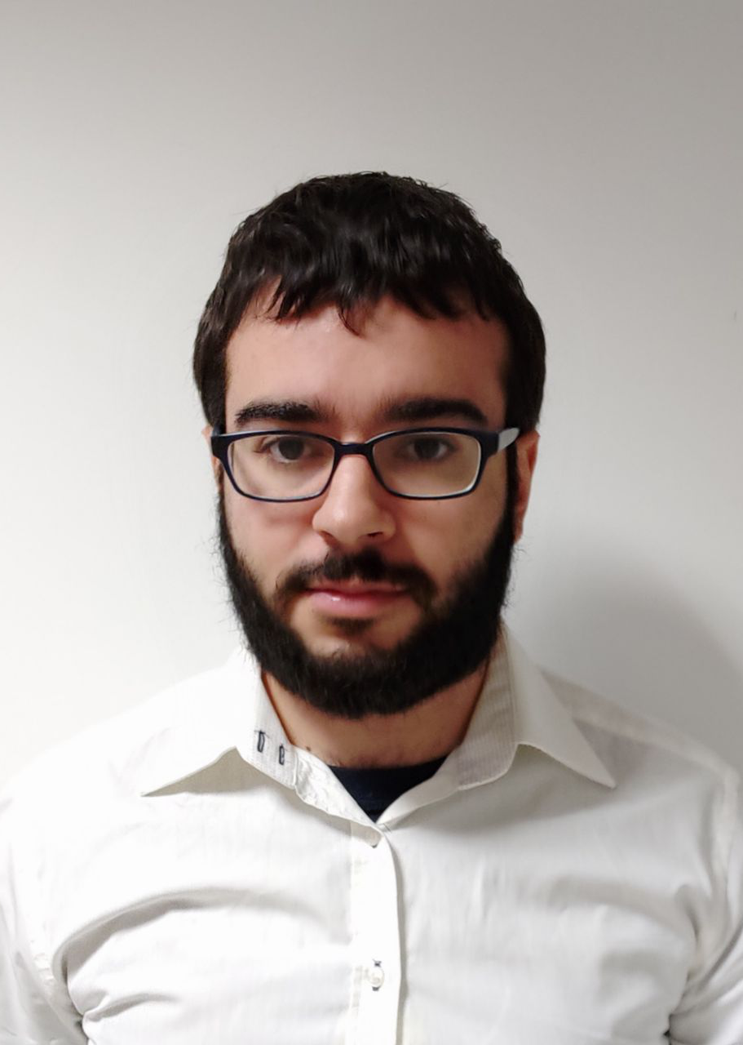
Team composition
= 100%
Iván Pérez Piñero | Antonio Arenas Arenas | Miguel Santos Batista | Pablo Pazo Jiménez
Backend developer | Frontend developer | Full-stack developer | Backend developer
100%
100%
100%
100%
20
/
20
17.5
/
21
(h)
20
/
18
16
/
15
Notes:
Grupo 7

Slide 30
Development plan
1 | 2 | 3 | 4 | 5 | 6 | 7 | 8 | 9 | 10 | 11 | 12 | 13 | 14

Slide 31

Development plan
1 | 2 | 3 | 4 | 5 | 6 | 7 | 8 | 9 | 10 | 11 | 12 | 13 | 14
Management and Testing
All the team
Parallel task – all project
10
/
10

Slide 32
Development plan
1 | 2 | 3 | 4 | 5 | 6 | 7 | 8 | 9 | 10
Fco. Javier de la Fuente
Developer tasks

Slide 33
Development plan
1 | 2 | 3 | 4 | 5 | 6 | 7 | 8 | 9 | 10
Error fixes
Fco. Javier de la Fuente
2
/
3
1
/
1

Slide 34
Development plan
1 | 2 | 3 | 4 | 5 | 6 | 7 | 8 | 9 | 10
Verify curriculum as manager
Fco. Javier de la Fuente
1
/
1

Slide 35
Development plan
1 | 2 | 3 | 4 | 5 | 6 | 7 | 8 | 9 | 10
Alejandro Monteseirín
Tasks

Slide 36
Development plan
1 | 2 | 3 | 4 | 5 | 6 | 7 | 8 | 9 | 10
Heroku investigation
Alejandro Monteseirín
3
/
3
2.5
/
4

Slide 37
Development plan
1 | 2 | 3 | 4 | 5 | 6 | 7 | 8 | 9 | 10
Export & delete user information
Alejandro Monteseirín
6.5
/
3

Slide 38
Development plan
1 | 2 | 3 | 4 | 5 | 6 | 7 | 8 | 9 | 10
Custom 404 view
Alejandro Monteseirín
3.5
/
4

Slide 39
Development plan
1 | 2 | 3 | 4 | 5 | 6 | 7 | 8 | 9 | 10
Pablo Pazo
Tasks

Slide 40
Development plan
1 | 2 | 3 | 4 | 5 | 6 | 7 | 8 | 9 | 10
Messaging system
Pablo Pazo
6
/
3

Slide 41
Development plan
1 | 2 | 3 | 4 | 5 | 6 | 7 | 8 | 9 | 10
Update models and populate
Pablo Pazo
1
/
1

Slide 42
Development plan
1 | 2 | 3 | 4 | 5 | 6 | 7 | 8 | 9
Miguel Santos
Tasks

Slide 43
Development plan
1 | 2 | 3 | 4 | 5 | 6 | 7 | 8 | 9
Previous version revisions
Miguel Santos
2
/
2
2
/
2

Slide 44
Development plan
1 | 2 | 3 | 4 | 5 | 6 | 7 | 8 | 9
New functionality
Miguel Santos
2
/
2
2
/
2

Slide 45
Development plan
1 | 2 | 3 | 4 | 5 | 6 | 7 | 8 | 9 | 10 | 11 | 12
Mario Bizcocho
Tasks

Slide 46
Development plan
1 | 2 | 3 | 4 | 5 | 6 | 7 | 8 | 9 | 10 | 11 | 12
Piloting plan
Mario Bizcocho
9.5
/
8

Slide 47
Development plan
1 | 2 | 3 | 4 | 5 | 6 | 7 | 8 | 9 | 10 | 11 | 12
Detect logged user
Mario Bizcocho
2
/
2

Slide 48
Development plan
1 | 2 | 3 | 4 | 5 | 6 | 7 | 8 | 9 | 10 | 11 | 12
Antonio Arenas
Tasks

Slide 49
Development plan
1 | 2 | 3 | 4 | 5 | 6 | 7 | 8 | 9 | 10 | 11 | 12
Piloting plan
Antonio Arenas
5.5
/
8

Slide 50
Development plan
1 | 2 | 3 | 4 | 5 | 6 | 7 | 8 | 9 | 10 | 11 | 12
Events
Antonio Arenas
3
/
3
1
/
1

Slide 51
Development plan
1 | 2 | 3 | 4 | 5 | 6 | 7 | 8 | 9
Iván Pérez
Tasks

Slide 52
Development plan
1 | 2 | 3 | 4 | 5 | 6 | 7 | 8 | 9
Legal information
Iván Pérez
2
/
2

Slide 53
Development plan
1 | 2 | 3 | 4 | 5 | 6 | 7 | 8 | 9
New challenge functionality
Iván Pérez
6
/
6

Slide 54
Development plan
1 | 2 | 3 | 4 | 5 | 6 | 7 | 8 | 9
Jorge Manuel Molina
Tasks

Slide 55
Development plan
1 | 2 | 3 | 4 | 5 | 6 | 7 | 8 | 9
Previous version revisions
Jorge Manuel Molina Domínguez
1
/
1
1
/
1

Slide 56
Development plan
1 | 2 | 3 | 4 | 5 | 6 | 7 | 8 | 9
Realistic database data
Jorge Manuel Molina Domínguez
1
/
1

Slide 57
Contents
What is Aim Games?
Demonstration
Where we are
Team composition
Productivity control
Piloting plan
Issues faced
Next steps

Slide 58


Piloting plan
Companies
TieSoft: Rafael Sánchez
Dual Mirror Games: Daniel Marín
Gunstar Studio: Rafael Casaucao
Base members
Alberto Sánchez
Vinnicios Thyago Dias
Francisco Sánchez
… Experience design testers
Anyone can join!
Around 50 members to be polled at street level
Notes:
Grupo 7

Slide 59
Piloting plan
Two stages
Defined use cases
Time tracking
No guidance
User experience testing
Two test roles

Slide 60
Contents
What is Aim Games?
Demonstration
Where we are
Team composition
Productivity control
Piloting plan
Issues faced
Next steps

Slide 61
Next steps
To do: improve MVP with customer & user feedback
Sprint meeting in the near future!
Main changes
Inner application currency
Message system rework
Curriculum promotion

Slide 62

Thank you for your time!
If I have seen further it is by standing on the shoulders of Giants
- Isaac Newton
Summer in Mara (Chibig, Valencia, 2019)
Any questions?
Notes:
Grupo 7

